Slide 1
Links
Abhijith Madhav (MT2013002)
Arjun S Bharadwaj (MT2013026)

Slide 2
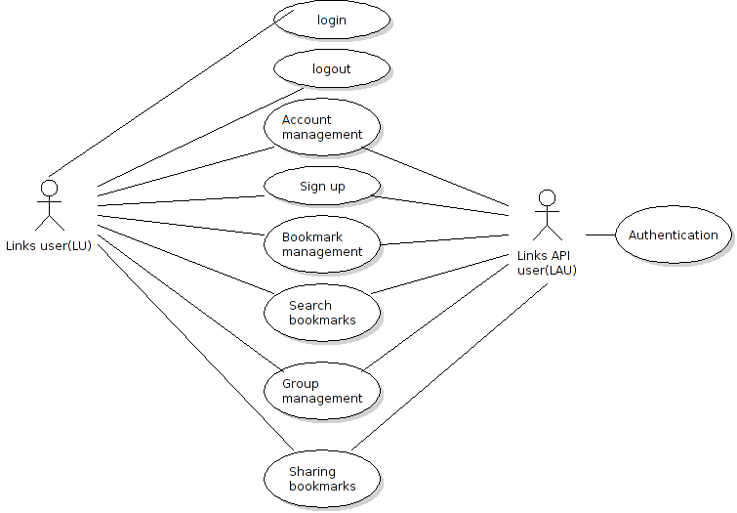
Use Cases & Features

Slide 3
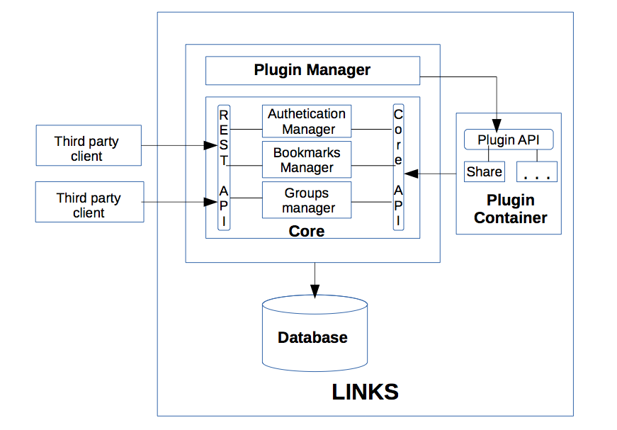
High Level Design

Slide 4
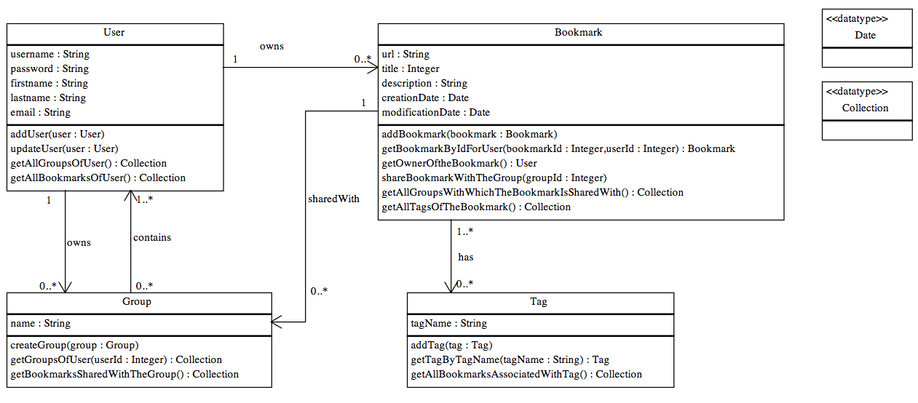
Low Level Design – Datamodel

Slide 5
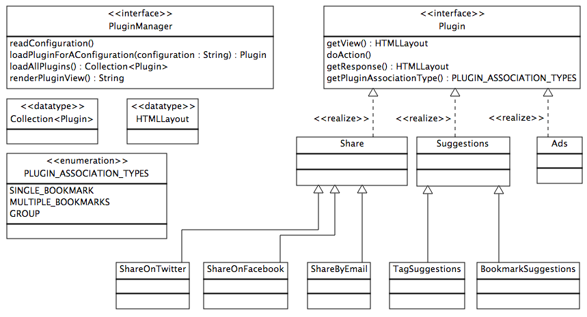
Plugin Architecture

Slide 6
Thank You

